Slide 1
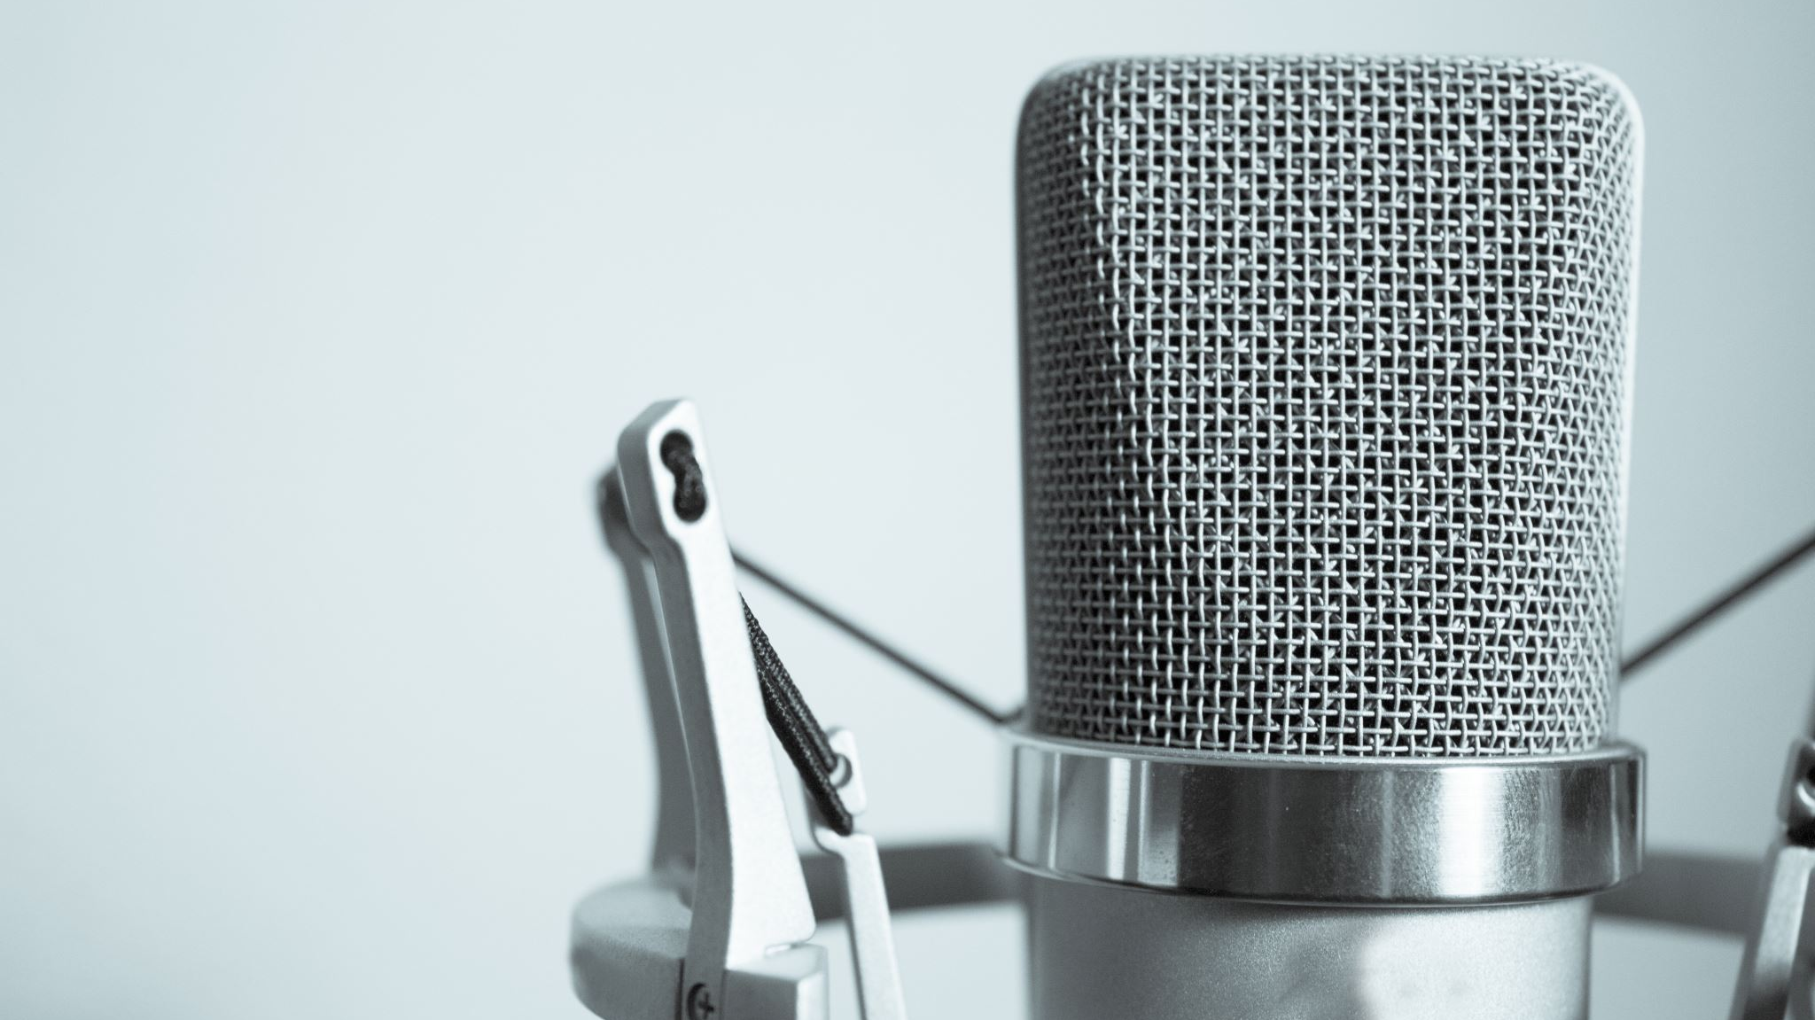
Podcasting
Space Brains Sci-Fi Film Festival 2023

Slide 2
Welcome
Acknowledgement of country
We want to acknowledge and pay respect to the Bindjareb people, who are the Traditional Owners and First Peoples of this land. I pay respect to the Elders past, present and emerging and acknowledge the continuing contribution they make to the life of this City and this region.

Slide 3
What’s the workshop about?
Who/Why did we start Space Brains Podcast?
How we started Space Brains Podcast?
Why start a podcast?
Preproduction
What you need to start a podcast?
Production
Hosting and graphics
Recording and editing
Post Production
Go through the physical steps
Do podcasts make money? If so, how?
Marketing
Tips of podcasting success
Notes:
Why start a podcast?
Why did we start Space Brains Podcast?
Theme / idea / passion needed - our start up story
How we started Space Brains Podcast?
What you need to start a podcast?
Equipment needed
Hosting and distribution
Tips of podcasting success:
Space Brains as an example of how to start a podcast
Do podcasts make money? If so, how?
Questions
3

Slide 4
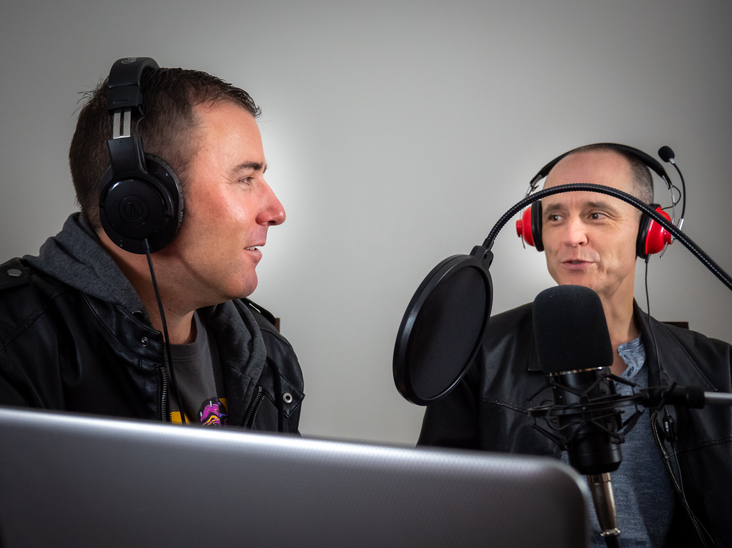
Why Space Brains Podcast?
We liked to chat > so why not press record?
Our wives said we can chat
Mark > filmmaker - expert on film
Surrey > sci-fi author - expert on sci-fi
Desire to inspire and encourage filmmakers/ sci-fi writers
What do you like about podcasts?
Notes:
Why did we start Space Brains Podcast?
Theme / idea / passion needed - our start up story
Because we were getting together and chatting and it always went back to sci-fi movies, books/ etc…
Mark > filmmaker - expert on film
Surrey > sci-fi author - expert on sci-f
Our wives said we can chat (to say the least), so why not press record?
Desire to inspire and encourage filmmakers/ sci-fi writers
Mark > i like podcasts are an in-depth interesting conversation on a topic
Surrey > I love that Podcasting allows me to express my enthusiasm and excitement about science and science fiction in a more personal way.
4

Slide 5
Your turn
Group of ¾
Introduce yourself.
What do you like about podcasts?
What podcasts do you listen to?
Favourite podcast.
Any that you hate?
Notes:
Why did we start Space Brains Podcast?
Theme / idea / passion needed - our start up story
Because we were getting together and chatting and it always went back to sci-fi movies, books/ etc…
Mark > filmmaker - expert on film
Surrey > sci-fi author - expert on sci-f
Our wives said we can chat (to say the least), so why not press record?
Desire to inspire and encourage filmmakers/ sci-fi writers
Mark > i like podcasts are an in-depth interesting conversation on a topic
Surrey > I love that Podcasting allows me to express my enthusiasm and excitement about science and science fiction in a more personal way.
5

Slide 6
Why start a podcast?
You like talking… a lot.
Niche idea = Sci-Fi films/ hopepunk/ joywatching
A podcast topic that doesn't already exist
Build a brand/ business/ expertise
Intimately connect with ears
Podcasts are booming
9 million Aussies listen
Notes:
Why start a podcast?
You like talking and don’t mind talking… a lot.
You have something to say about a niche idea - subjects matter
Notice there is a podcast topic that doesn't already exist or isn’t presented a certain way.
You want to build a brand
You get to be a niche, and audiences want to niche <not sure what?>
Connect with your audience - intimately
Podcasts are booming and the Coronavirus pandemic has made that fact more true than ever.
Millions of people all around the world are now listening to podcasts on a daily basis.
Data from 2021 shows that podcasts reach around 9 million Aussies* (https://takeatumble.com.au/insights/lifestyle/podcast-statistics-Australia)
6

Slide 7
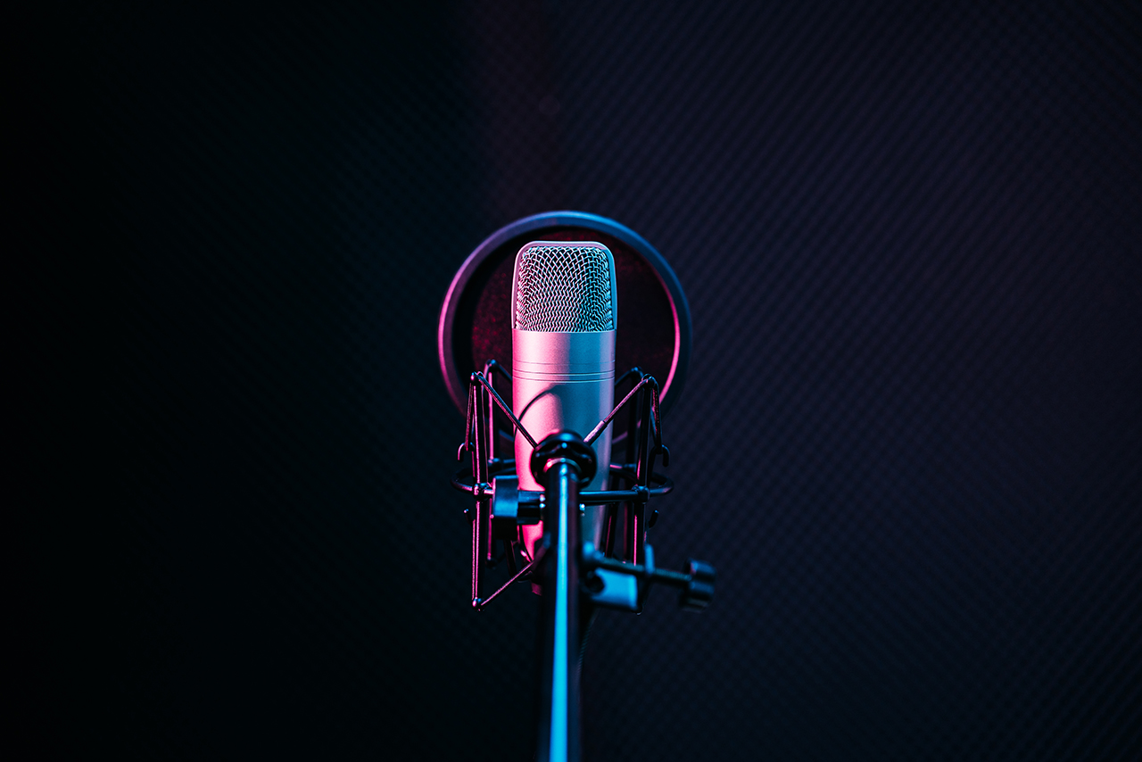
Types of podcast
Interview
Solo
Expert
Journalism
Story-telling
Promotional
Business
Seasonal
NB – All podcasts incorporate most these into their style

Slide 8
Do you like a type? What do you listen to?
Interview
Solo
Expert
Journalism
Story-telling
Promotional
Business
Seasonal

Slide 9
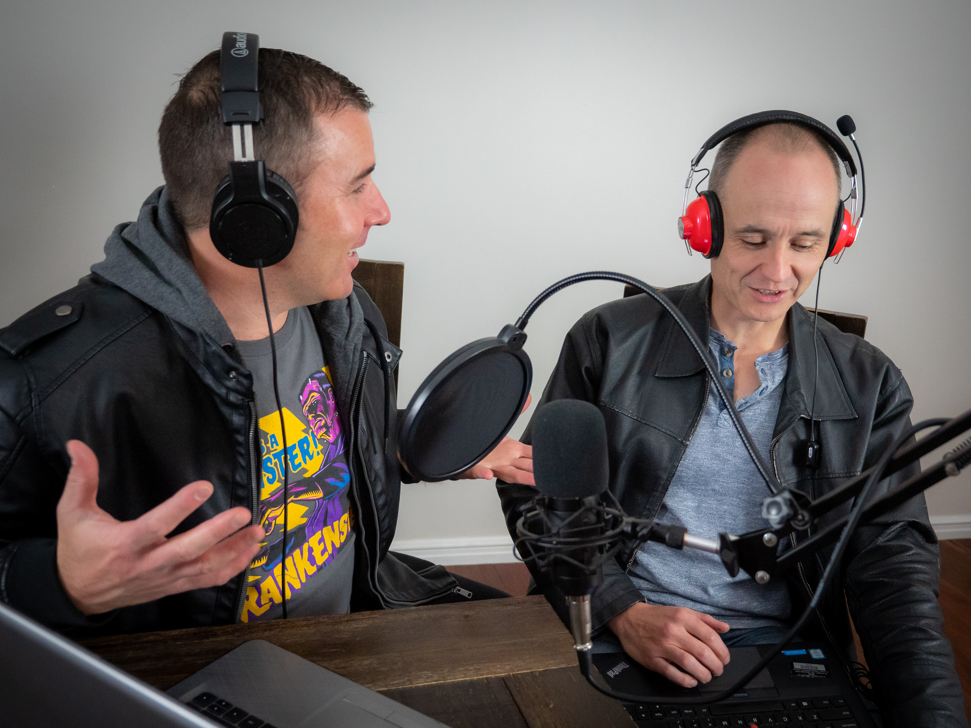
How we started Space Brains Podcast?
Minimal equipment
Microphone
Recording to phone
Free audacity editing software,
free Presonus Studio One tracking software
Pinecast for hosting.
Out the back of Surrey’s house in the granny flat
Point of difference/Niche > Joy-watch, hope punk > tone
Script of the show - originally a fairly blow-by-blow recounting of the film with commentary.
Notes:
How we started Space Brains Podcast?
Bare minimum equipment
Microphone
Recording to phone
Free audacity editing software, free Presonus Studio One tracking software
Pinecast for hosting.
Out the back of Surrey’s house in the granny flat
Listen to other movie podcasts - what we liked and what we didn’t like?
Point of difference > Joy-watch, hope punk > tone
Script of the show - originally a fairly blow-by-blow recounting of the film with commentary.
9

Slide 10
Your turn
By Yourself – write down
Have you got a podcast idea?
What’s your subject matter?
What’s your niche?
Who is your target audience?
Share in groups for 5 minutes

Slide 11
Share
Share in your groups of ¾ for 5 minutes your idea:
Have you got a podcast idea?
What’s your subject matter?
What’s your niche?
Who is your target audience?

Slide 12
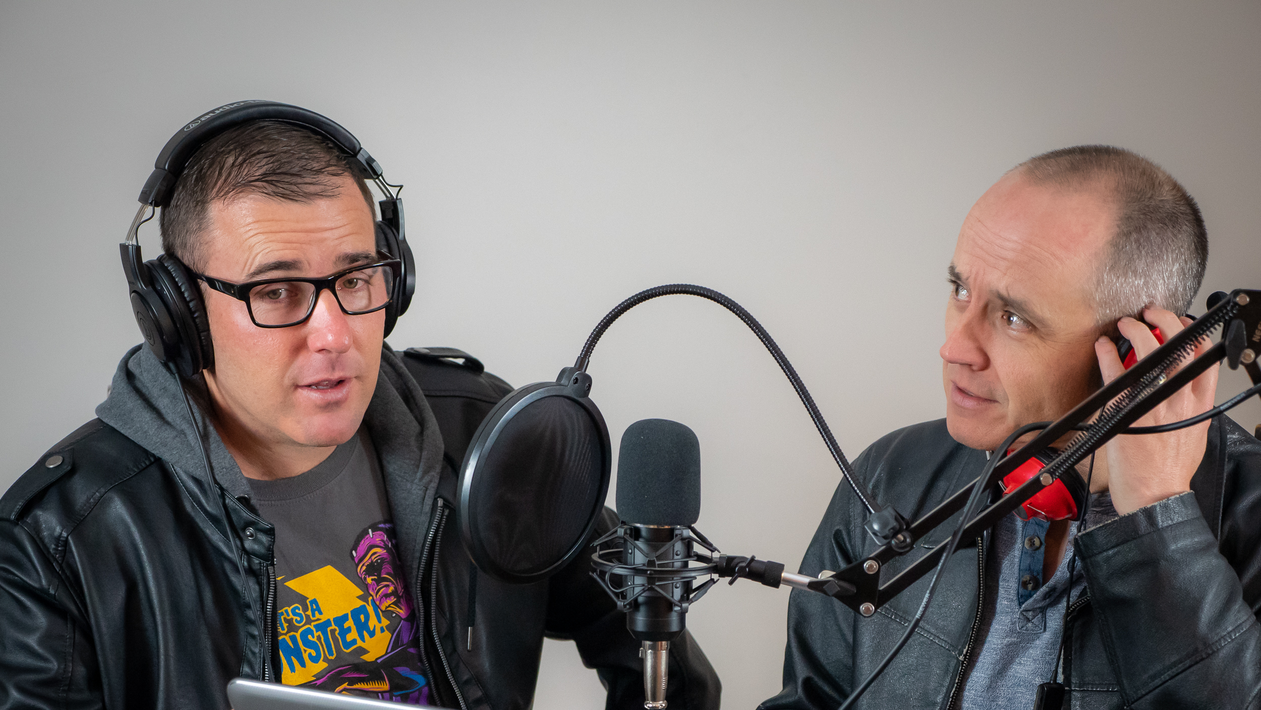
Equipment/ software you need?
Microphone
A recording device
Editing software to make it sound good
Graphics
Podcast host
Quiet recording space
Notes:
What is equipment and software are needed to start a podcast?
Microphone
A recording device
Editing software to make it sound good
Graphics
show logo
Episode images
Podcast host
Quiet recording space
12

Slide 13
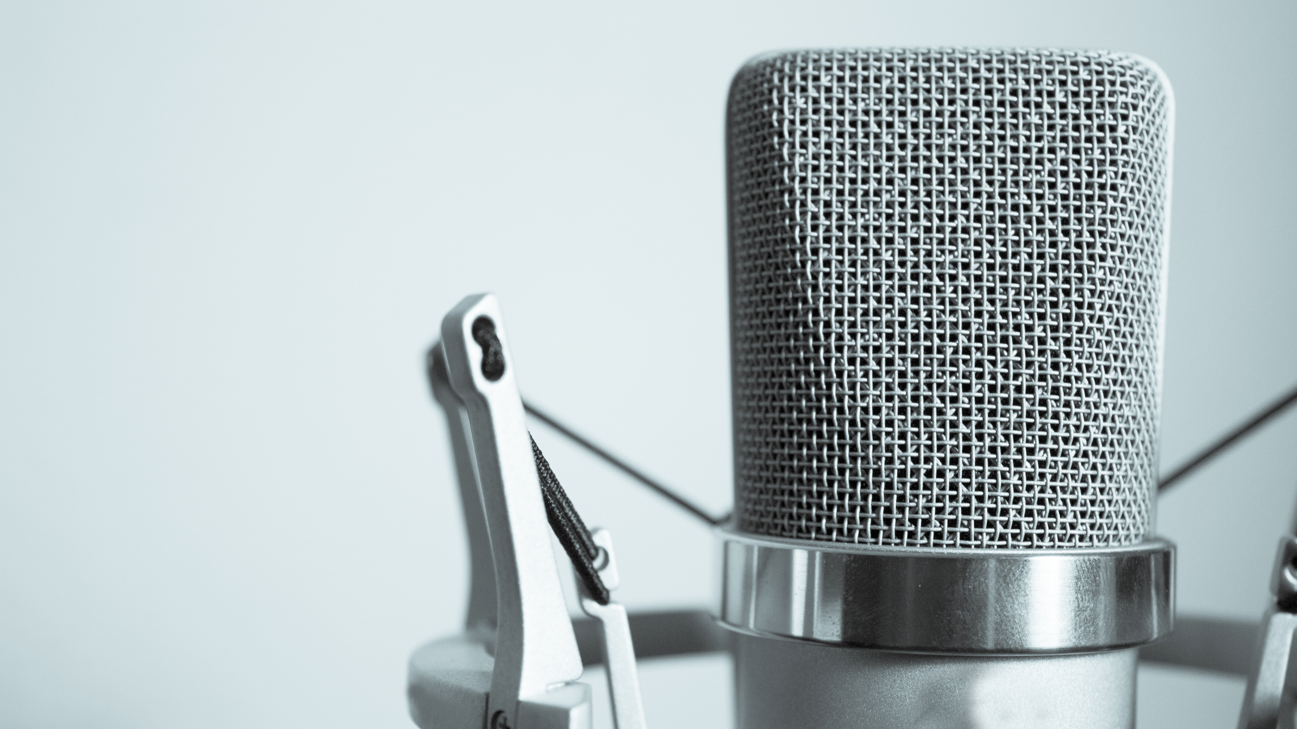
Recommended Equipment?
Microphones
Lapels + $2 Aliexpress special > $77 Rode smartLav+ Smart Device Microphone.
$60 condenser mic with boom, anti-pop shield and phantom power
Mixer = $70 Aliexpress > $170 Amazon > Rhodecaster Pro $850
Headphones / earbuds
Recording devices
Mobile phone >
Recording location
Quiet with few flat, hard surfaces to reduce echo.
Computer > All-in-one mixer like Rhodecaster Pro
Notes:
what do we recommend?
Microphones
Lapels from $2 Aliexpress special to $77 Rode smartLav+ Smart Device Microphone. – recommend to start
Upgrade to $60 condenser mic with boom, anti-pop shield and phantom power
Mixer from $70 Aliexpress to $170 Amazon up to Rhodecaster Pro $850
Headphones / earbuds at least as good as your audience will use for editing and sound monitor / checking
Recording devices
Mobile phone – recommended to start
Computer
All-in-one mixer like Rhodecaster Pro
Recording location
Quiet with few flat, hard surfaces to reduce echo.
Car
Granny flat
Walk in robe
Bedroom
Rented studio
Editing / mixing software
Adobe Audition - $29.99 per month
Apple - Quicktime - very basic editing on Mac – recommended
Audacity + Presonus Studio One – recommended
13

Slide 14
Recommended Equipment?
Editing / mixing software
Adobe Audition - $29.99 per month
Apple - Quicktime - very basic editing on Mac – recommended
Audacity + Presonus Studio One – recommended
Notes:
what do we recommend?
Microphones
Lapels from $2 Aliexpress special to $77 Rode smartLav+ Smart Device Microphone. – recommend to start
Upgrade to $60 condenser mic with boom, anti-pop shield and phantom power
Mixer from $70 Aliexpress to $170 Amazon up to Rhodecaster Pro $850
Headphones / earbuds at least as good as your audience will use for editing and sound monitor / checking
Recording devices
Mobile phone – recommended to start
Computer
All-in-one mixer like Rhodecaster Pro
Recording location
Quiet with few flat, hard surfaces to reduce echo.
Car
Granny flat
Walk in robe
Bedroom
Rented studio
Editing / mixing software
Adobe Audition - $29.99 per month
Apple - Quicktime - very basic editing on Mac – recommended
Audacity + Presonus Studio One – recommended
14

Slide 15
Recommended Equipment?
Hosting:
Pinecast.com to host – recommended
a free tier that can be upgraded and allows multiple podcasts under the one user.
Multiple shows under one user
Libsyn
One of the original, very reliable.
Old UI, awkward to use
“Expensive”
Others: Blubrry, Buzzsprout, Anchor, Podbean, Spreaker etc…
Graphics
Canva
Picmonkey
Fiverr
Notes:
what do we recommend?
Hosting:
Pinecast.com to host – recommended
a free tier that can be upgraded and allows multiple podcasts under the one user.
Multiple shows under one user
Libsyn
One of the original, very reliable.
Old UI, awkward to use
“Expensive”
Others: Blubrry, Buzzsprout, Anchor, Podbean, Spreaker etc…
Graphics
Canva
Picmonkey
Fiverr
15

Slide 16
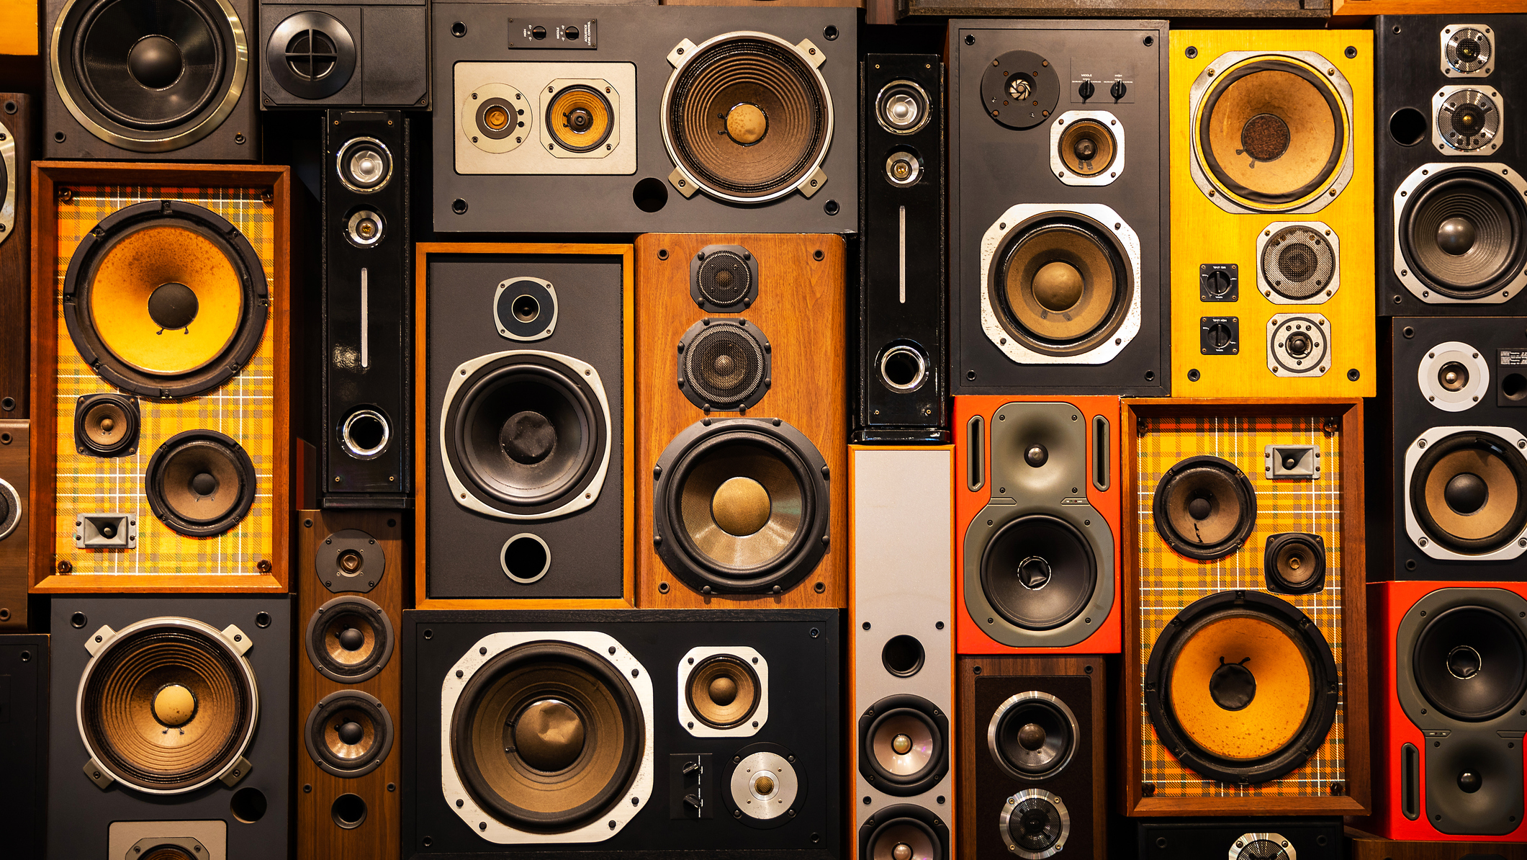
Music/ sound FX
Copyright-free music
Creative Commons
YouTube audio library
Soundstripe $29 per month
Individual artists / freelancers e.g.: from fiverr.com
Danosongs.com for a one time $50 fee you get a big list of music
Notes:
Music/ sound FX:
Copyright-free music but credit the musician/ band by providing credit.
Creative Commons – royalty-free music but some of these sites want you to subscribe and pay for a subscription. https://creativecommons.org/about/program-areas/arts-culture/arts-culture-resources/legalmusicforvideos/
YouTube audio library > https://www.youtube.com/audiolibrary
Soundstripe > https://app.soundstripe.com/ > $19.99 US per month
Individual artists / freelancers eg: from fiverr.com
I used Danosongs.com for a one time $50 fee you get a big list of music
16

Slide 17
Promotion
Posters
Trailers
Social media
Website (many hosts provide one)
Media – traditional and digital
Photos
Notes:
Tips for podcasting success:
Commit to make it past 6 episodes (26% of the 2million podcasts on Apple have just 1 episode)
Have a clear pace, schedule and/or season > Space Brains fortnightly for the whole year but you might do seasons
Be aware of the time commitment.
Space Brains
Recording episode = 2.5 hours / 2 weeks
Watching the movie = 1.5-2 hours / 2 weeks
Notes, research = 2 hours / 2 weeks
Editing, mixing posting = 2-3 hours / 2 weeks (started out as double)
Total = about 9 hours / 2 weeks just to record and release (not including promo, planning, film festival etc…)
Have a point of difference
Market your podcast (must have)
Create a strategy and budget (can be $0)
Look, feel, vibe, tone of your podcast - this should be in your imagery, brand of your podcast
Who is your audience?
Networking > https://hello.spacecubed.com/perth-podcast-festival
Promotion –
Social media
Choose one or two channels, and do your best to consistently promote
Create a page for your podcast
Share in groups >
posters, trailers
Website – build a website, build an audience (many hosts provide one)
Media – traditional and digital
Photos
Networking > https://hello.spacecubed.com/perth-podcast-festival
17

Slide 18
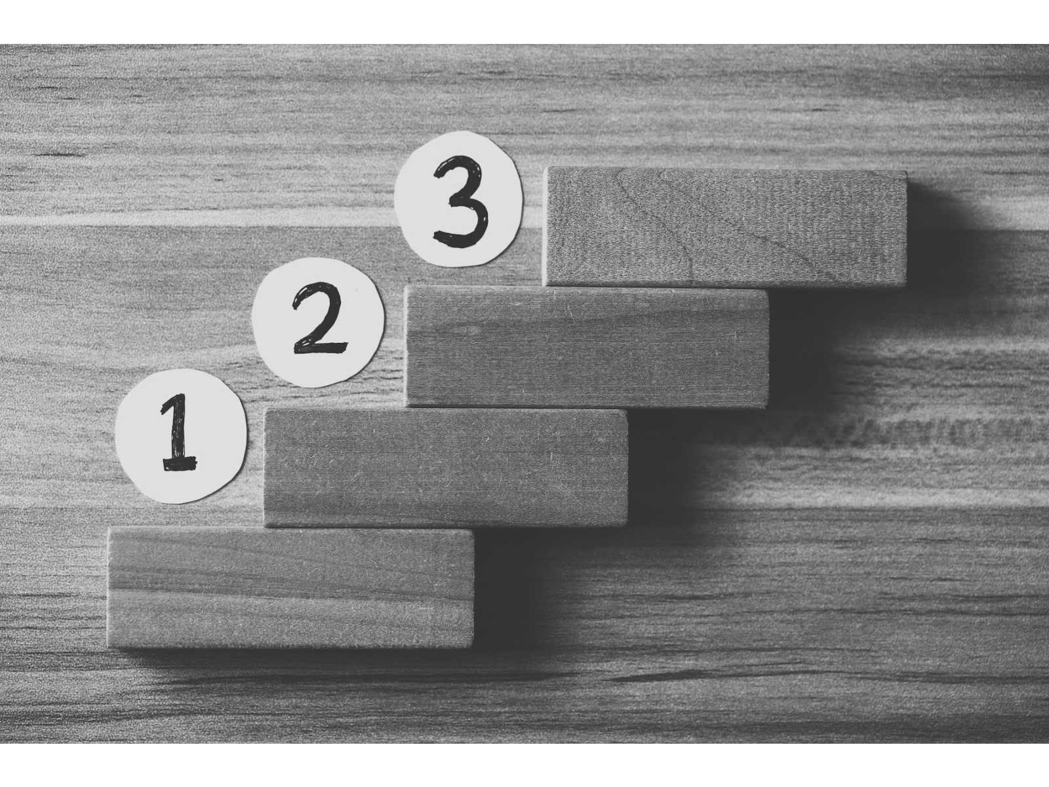
Let’s Make a Podcast
Publish
Record and Edit
Cover Art
Create a Topic and Title

Slide 19
Let’s Create a Podcast
Form into groups ¾
Some ideas to explore:
response to other media?
Sport or political commentary
News roundup
Story telling
Interview
Crime
Conspiracy
Pick a Title
Things to remember:
There is little space available on a phone screen
Odd or specific titles are easier to remember
Keep it somewhat on topic or theme

Slide 20
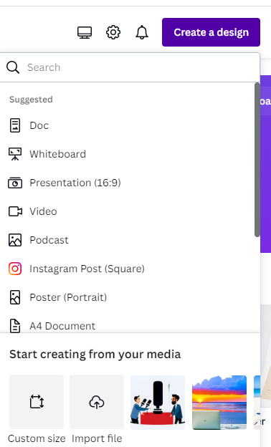
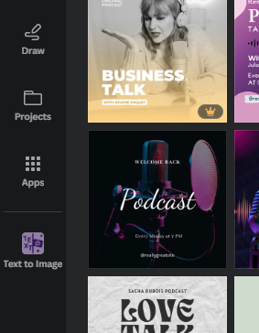
Make some cover art
Use canva AI image:
Visit: https://canva.com
Sign in or create a free account
Create a design: select Podcast template
Select Text to image

Slide 21
Record and Edit
Download Audacity for windows or mac
Visit https://www.audacityteam.org/download/
Select the correct version (Windows/Mac/Legacy)
Follow the installation instructions
Record a brief 1-2 sentence introduction for your podcast
Edit it using

Slide 22
Publish
Create a dummy podcast on Pinecast.com
Visit: https://www.pinecast.com/
Create an account, no credit card needed for free account
New episode, fill in details, upload and save

Slide 23
Do podcasts make money?
Joe Rogan does
Takes 6 years before making money
Advertising
sponsorship
Related events
Books, merch
Sell media rights
Notes:
Do podcasts make money?
Joe Rogan does.
Passion for what you are doing matters
Bulk of money earning podcasts started by non-professionals were older than 6 years before making money
Advertising
Other sponsorship
Related events
Last Podcast on the Left and No Such Thing as a Fish do ticketed live shows
Workshops
Books, merch
Adventure Zone
Book of the Year
Last Book on the Left
Sell media rights
Archive 81
Lore
Limetown
Comedy Bang Ban
Critical Role
23

Slide 24
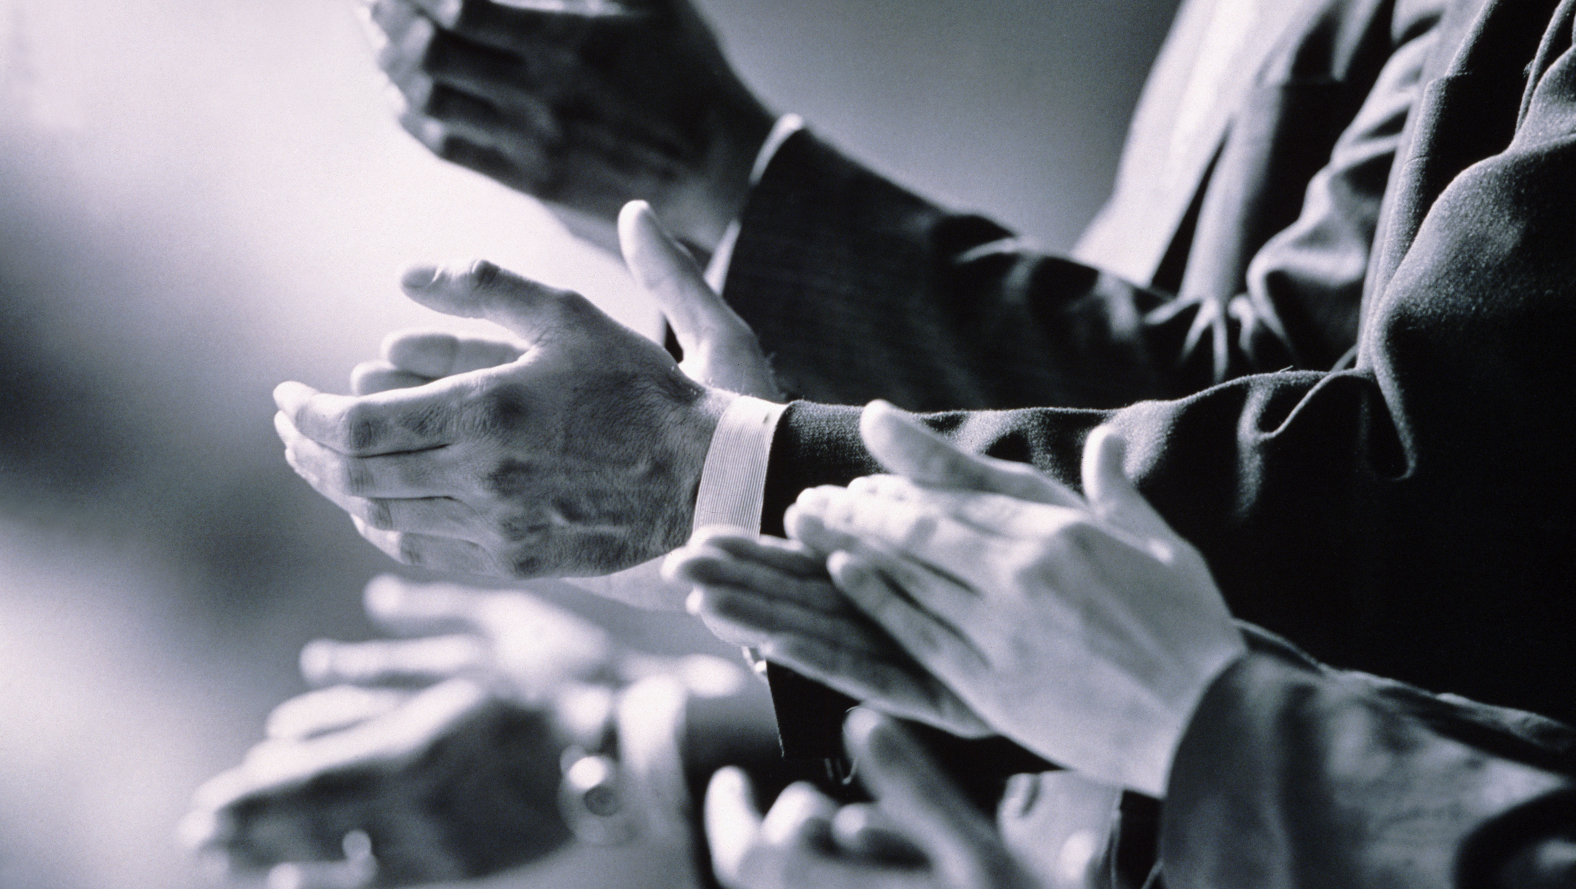
Tips for podcasting success:
6 episodes + (26% of the 2million podcasts on Apple have just 1 episode)
Have a clear pace, schedule and/or season > Space Brains fortnightly
Time commitment
Point of difference
Market your podcast
Create a strategy and budget (can be $0)
Look, feel, vibe, tone of your podcast - this should be in your imagery, brand of your podcast
Who is your audience?
Notes:
Tips for podcasting success:
Commit to make it past 6 episodes (26% of the 2million podcasts on Apple have just 1 episode)
Have a clear pace, schedule and/or season > Space Brains fortnightly for the whole year but you might do seasons
Be aware of the time commitment.
Space Brains
Recording episode = 2.5 hours / 2 weeks
Watching the movie = 1.5-2 hours / 2 weeks
Notes, research = 2 hours / 2 weeks
Editing, mixing posting = 2-3 hours / 2 weeks (started out as double)
Total = about 9 hours / 2 weeks just to record and release (not including promo, planning, film festival etc…)
Have a point of difference
Market your podcast (must have)
Create a strategy and budget (can be $0)
Look, feel, vibe, tone of your podcast - this should be in your imagery, brand of your podcast
Who is your audience?
Networking > https://hello.spacecubed.com/perth-podcast-festival
Promotion –
Social media
Choose one or two channels, and do your best to consistently promote
Create a page for your podcast
Share in groups >
posters, trailers
Website – build a website, build an audience (many hosts provide one)
Media – traditional and digital
Photos
Networking > https://hello.spacecubed.com/perth-podcast-festival
24

Slide 25
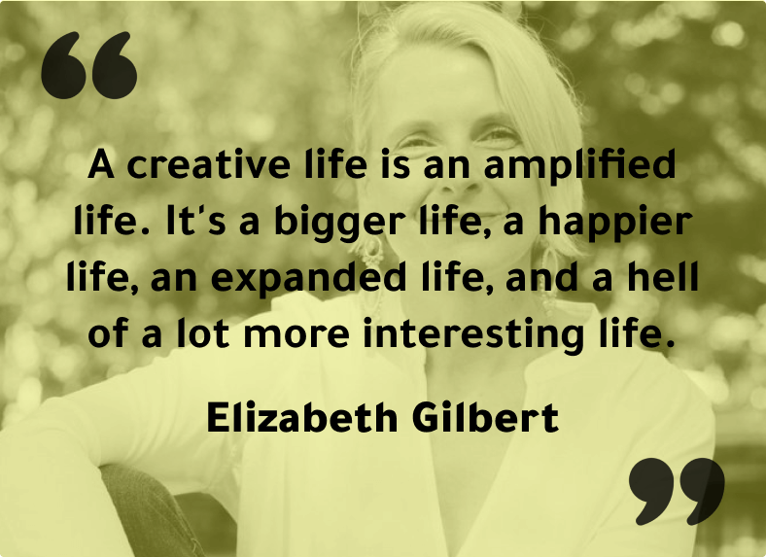
Inspirational podcast quote
Notes:
Inspirational podcast quote
25

Slide 26
Make a commitment to yourself
I am creating a podcast on…. and will launch it by….
Signed – your name

Slide 27
Any questions?
Notes:
Questions?
27

Slide 28
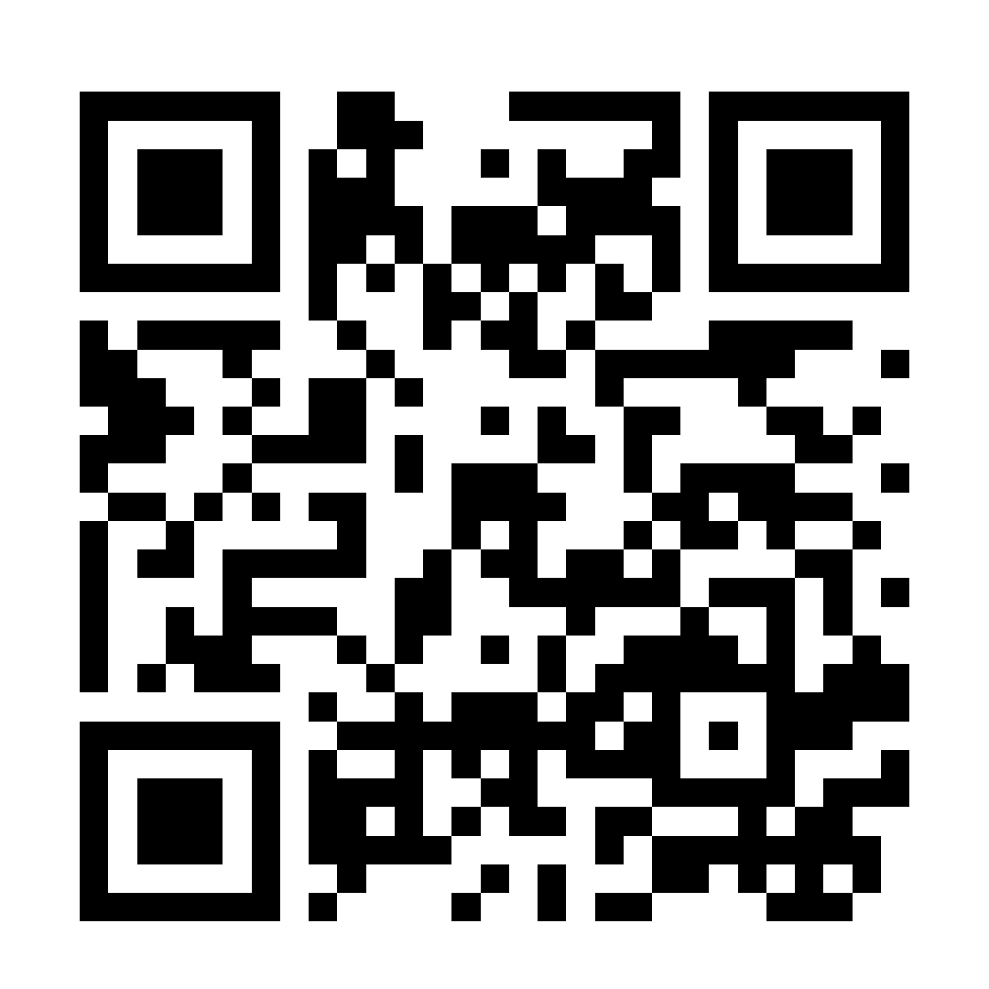
Connect with Space Brains
Listen > Apple Podcasts/ Spotify
spacebrains.com.au
YouTube
Facebook
Instagram
Email
Notes:
28

